Slide 2
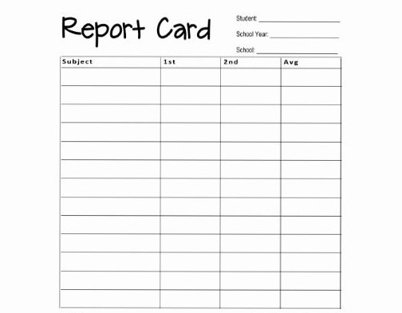

Stephen
2018/19
All Saints
Effort
Grade
Comment
Love
Average
C
Joy
Average
C
Peace
Poor
D
Patience
Very Poor
U
Kindness
Good
B
Goodness
Average
C
Gentleness
Poor
C
Faithfulness
V Good
B
Self Control
Awful
T
See me!

Slide 3


Slide 4


Slide 5


Slide 6


Slide 7


Slide 8


Slide 9
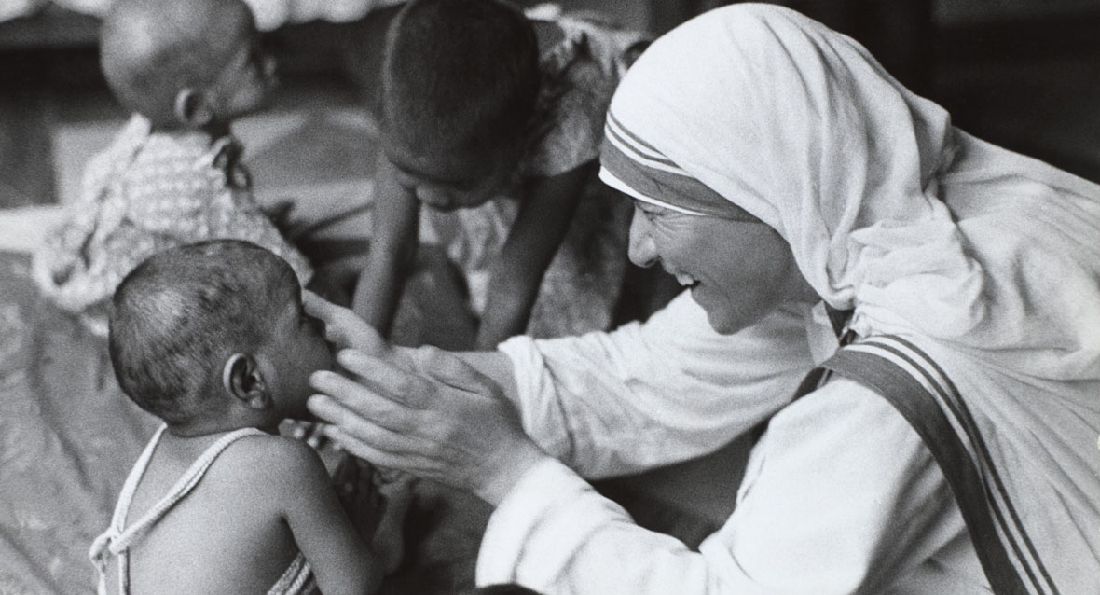

Slide 10
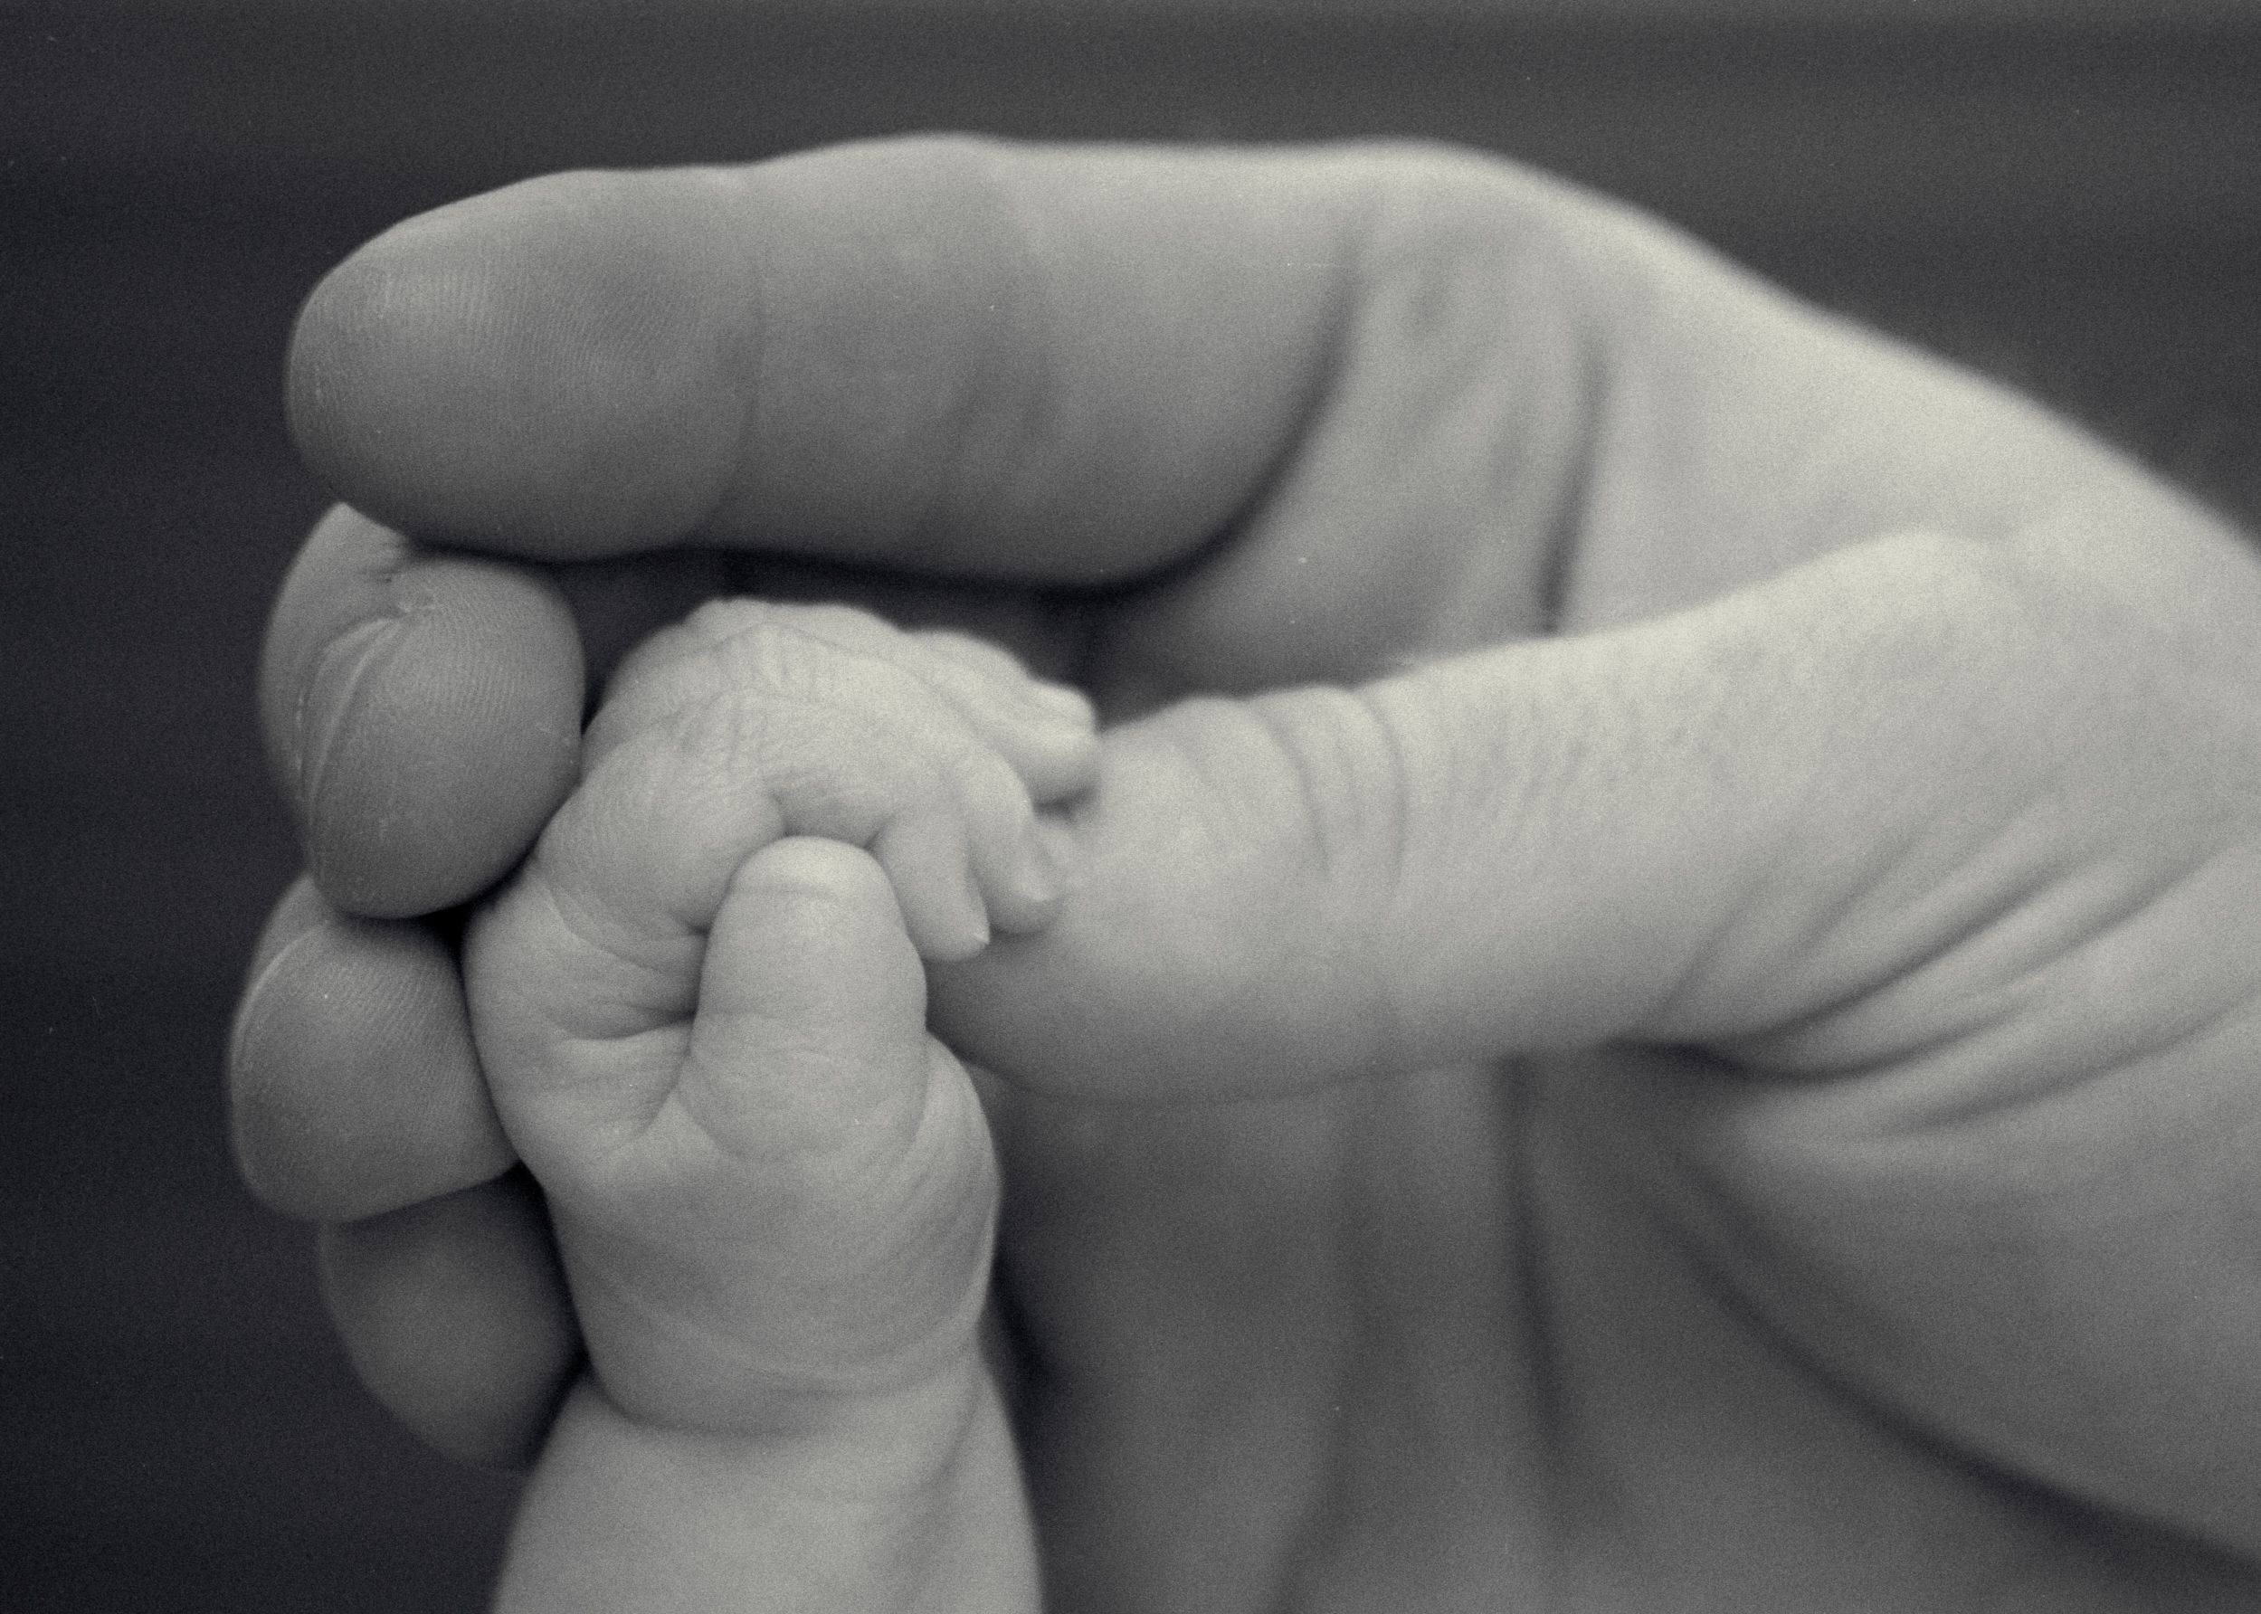

Slide 11


Slide 12


Slide 13
Stephen
2018/19
All Saints
Effort
Grade
Comment
Love
Average
C
Joy
Average
C
Peace
Poor
D
Patience
Very Poor
U
Kindness
Good
B
Goodness
Average
C
Gentleness
Poor
C
Faithfulness
V Good
B
Self Control
Awful
T
See me!

Slide 14


Slide 15


