Slide 1
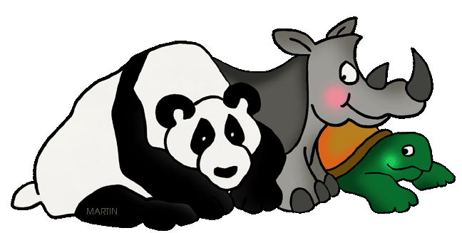
Endangered Animals

Slide 2
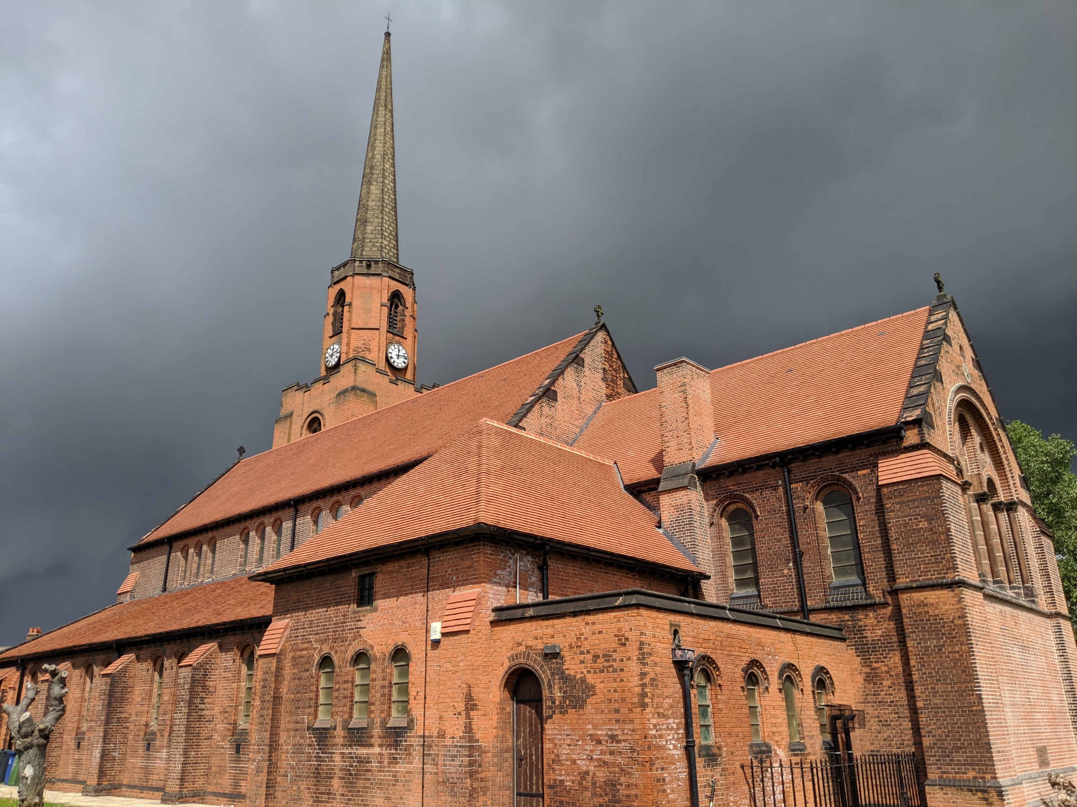

Slide 5


Slide 8
Endangered Animals

Slide 9
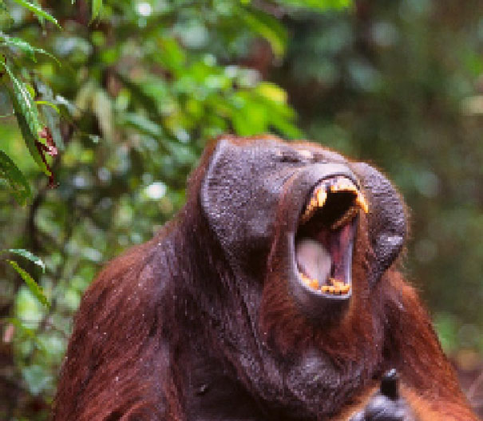
Borneo Orangutan - 45,000 to 69,000

Slide 10
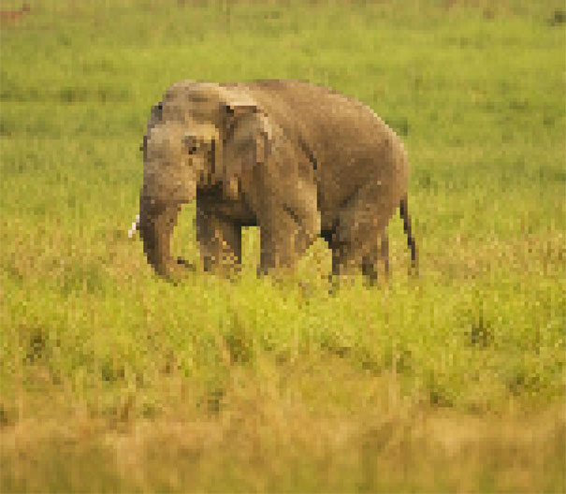
Indian Elephant – 20,000 to 25,000

Slide 11
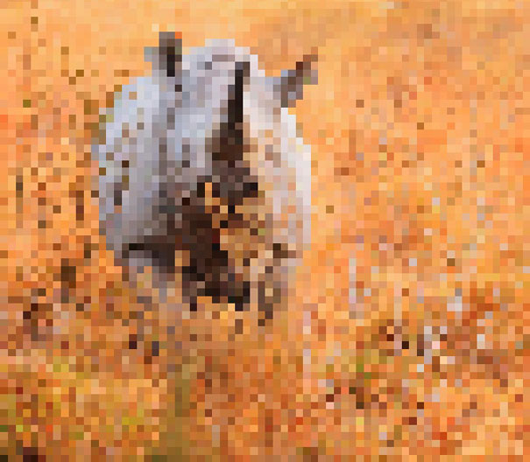
Black Rhino - 5,000

Slide 12
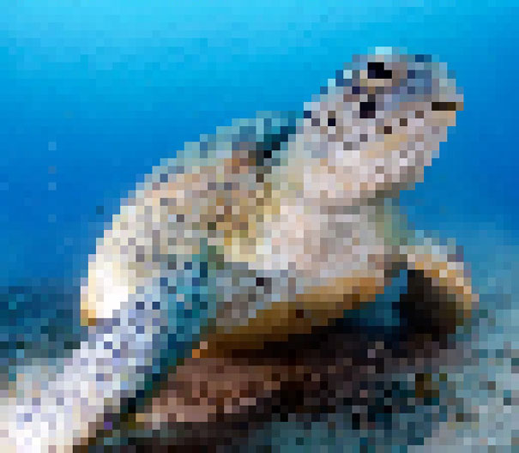
Green Sea Turtle – 3,000 to 5,500

Slide 13
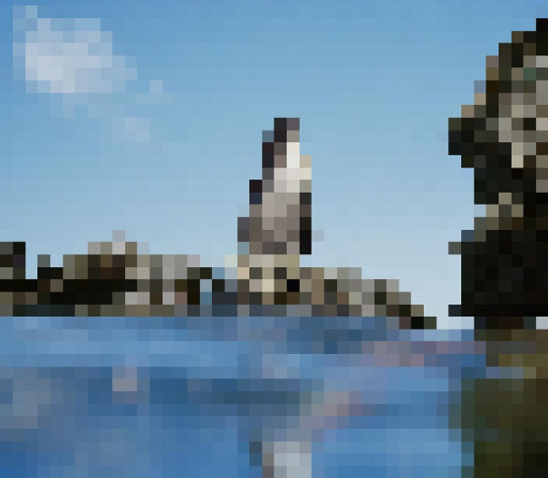
Galapagos Penguins - 2,000

Slide 14
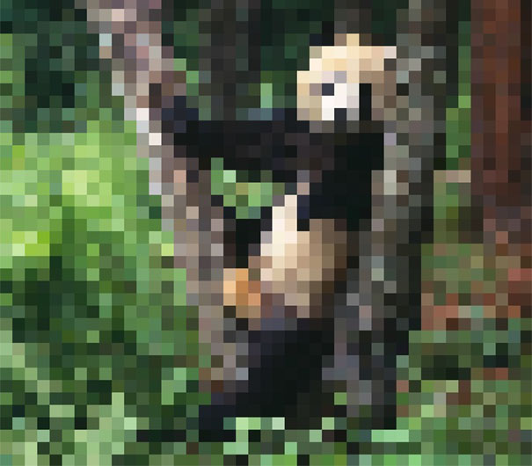
Giant Panda - 1864

Slide 15

Amur Tiger - 450

Slide 16

Amur Leopard - 60

Slide 17
Formosan Clouded Leopard -
0

Slide 18


Slide 19


